Slide 1
EKALAVYA ONLINE EXAM
KNOWLEDGE IS POWER….TEST IT……
TEAM MEMBERS
ANUKOOL SRIVASTAVA
HARICHANDANA REDDY
VARSHA ALGAWADI
SAMBIT KU. PATRA

Slide 2
Problem Statement
EKALAVYA is a web portal which is developed a or implemented in Java domain. This project will help various students and organisations to give and conduct examinations. In this age of competition, organisations find it difficult to visit every college to conduct placement drives. It becomes time consuming for them to visit every location. This does not help students from low grade colleges having calibre to showcase their talent to them as they do not get the exposure to land in the job profiles of their choices.
To reduce this gap and help the deserving candidates showcase their talent, an online exam system can be used. Basically we are providing an online exam portal where we host exams. This will not only help the companies analyse but also select cream candidates that will meet their requirements.

Slide 3
PROJECT OBJECTIVE:
Online Examination System can reduce the hectic job of assessing the answers given by candidates manually.
Responses or the answers by the candidates can be checked automatically and instantly.
It will reduce paper work to be an integrated Online Examination System.
The result can be shown immediately to the students reducing the anxiety.
Can create various reports and graphs for evaluation purpose almost instantly when and where required.

Slide 4
ROLES AND RESPONSIBILITIES
Anukool Srivastava:
Registration
Database Planning and Execution.
Angular Routing.
Exam Management.
Registration of User’s data into Database.
Email and password.
Session’s Management.
Mapping

Slide 5
ROLES AND RESPONSIBILITIES
Harichandana Reddy:
Database-Oracle(Tables,Queries,Inserations,Deletions)
Email and password in back end.
Creation of Entities in JPA.
UI related to Exam.
Add Questions.
Varsha:
Home page and Routing.
Sessions.
JPQL Queries in JPA.
Fetching Exam Data.

Slide 6
ROLES AND RESPONSIBILITIES
Sambit Patra:
Login(Backend,FrontEnd)
Entity Creation and Test.
Bootstrap.
Table Mapping.
User Interface(Registration,Login,Homepage)
Database Management.

Slide 7
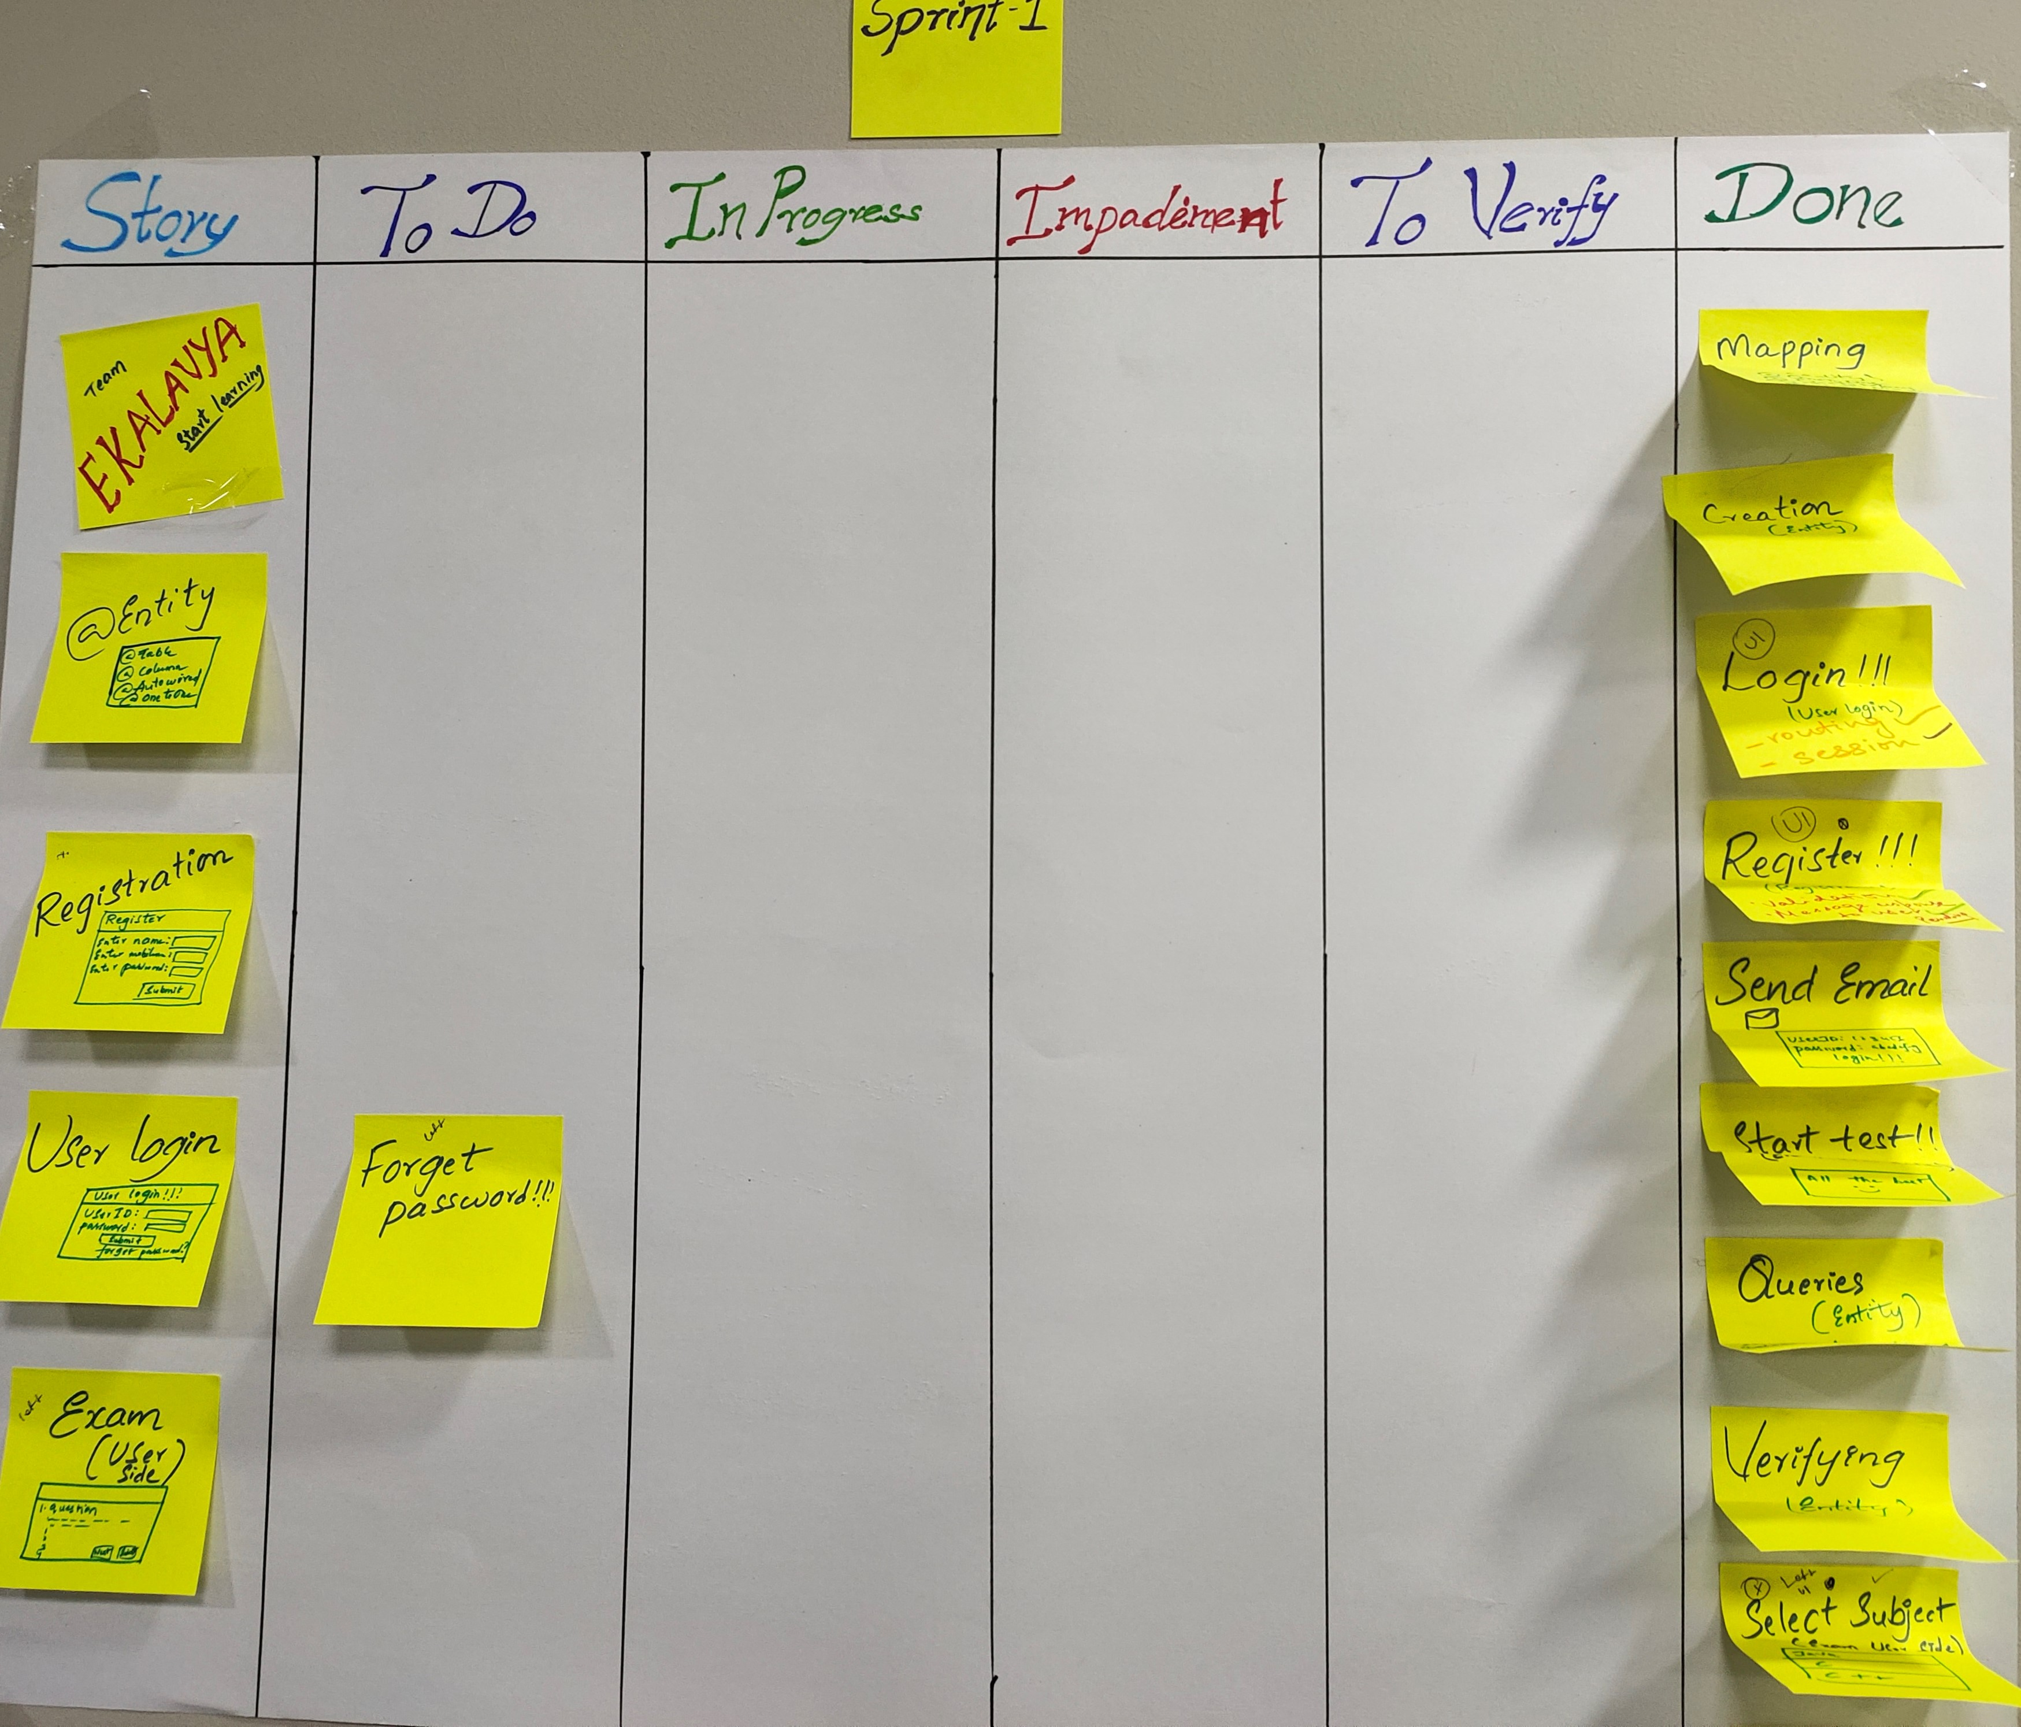
SPRINT-1 COMPONENTS

Slide 8
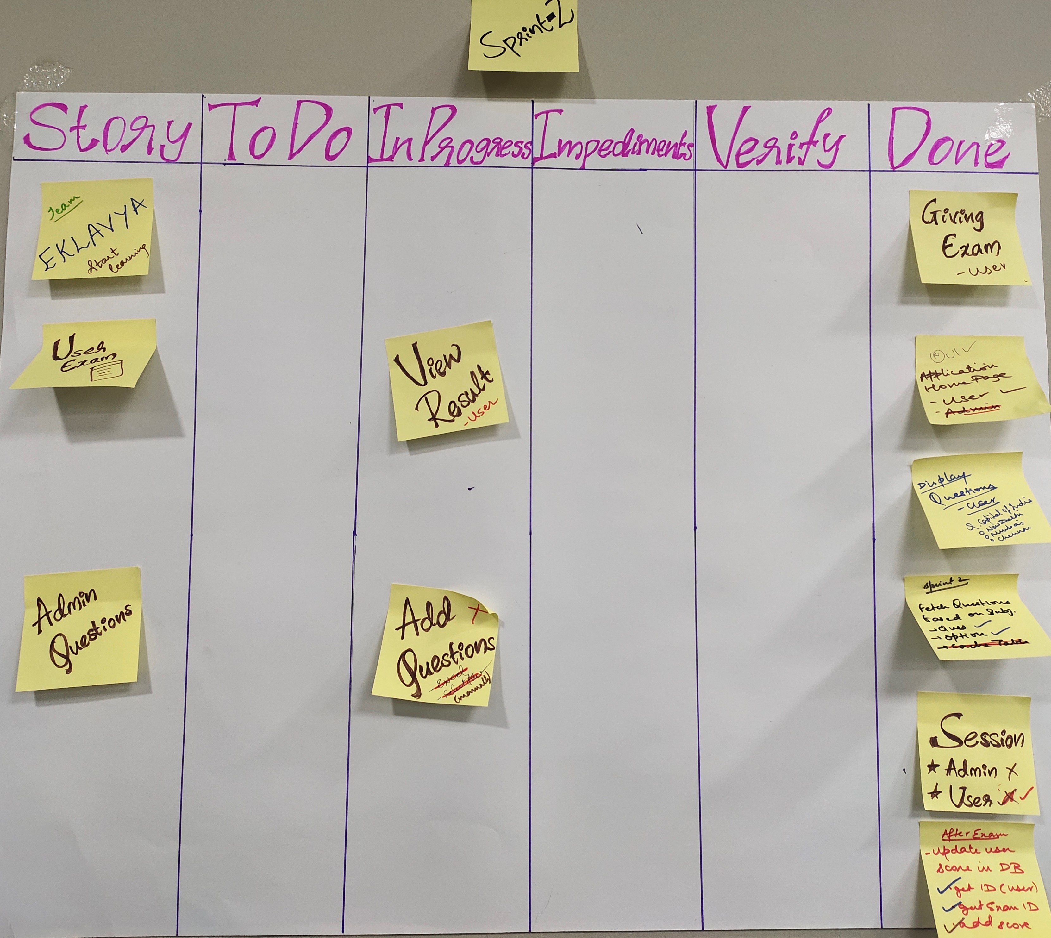
SPRINT-2 COMPONENTS

Slide 9
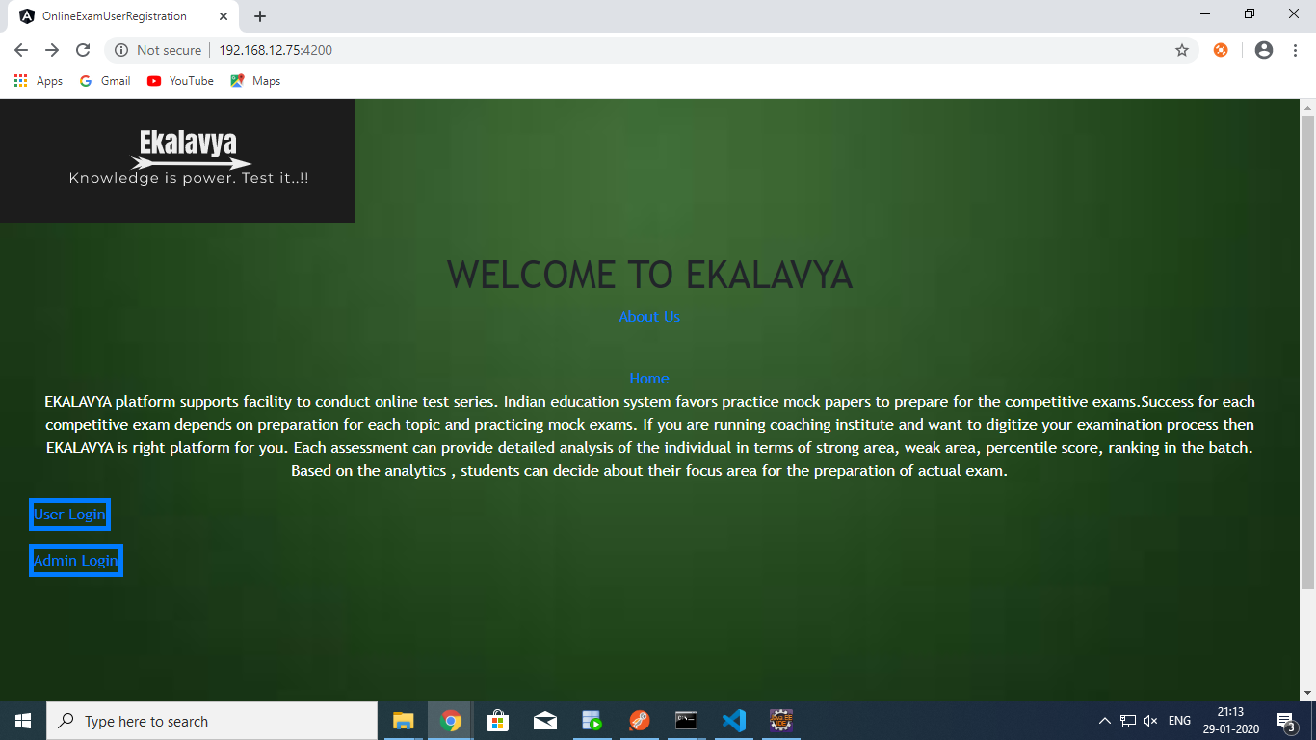
Homepage

Slide 10
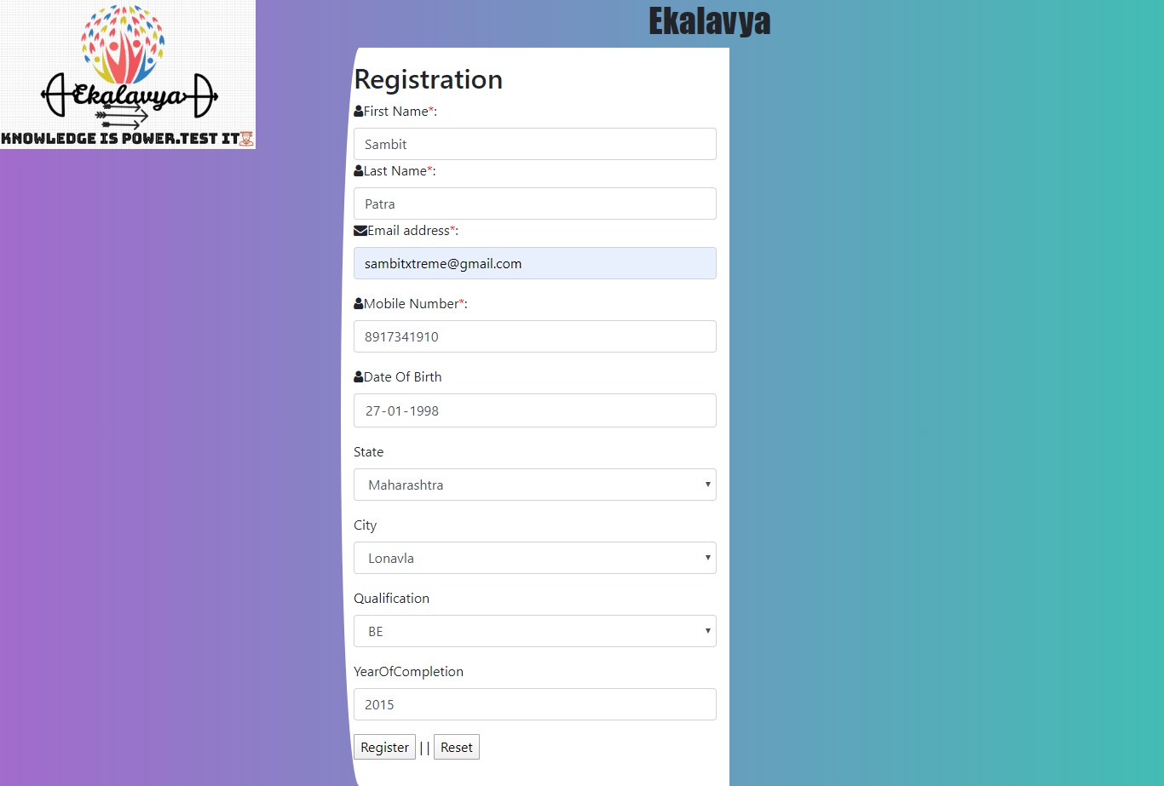
User Registration

Slide 11
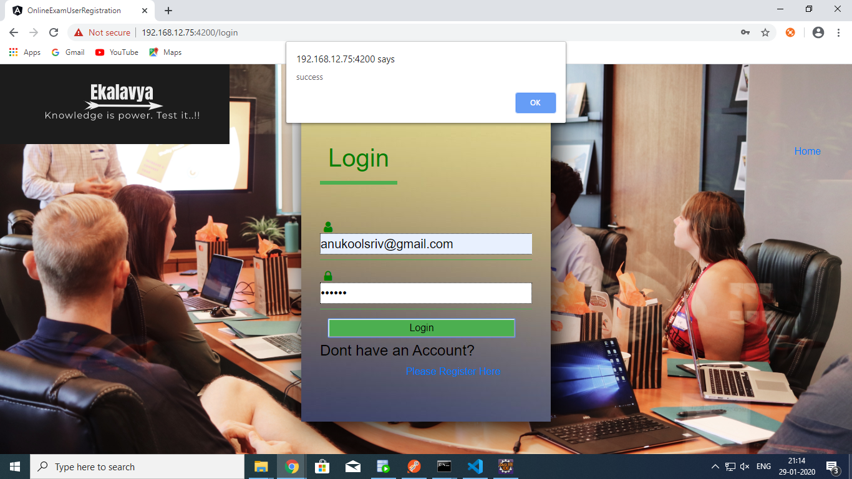
User Login

Slide 12
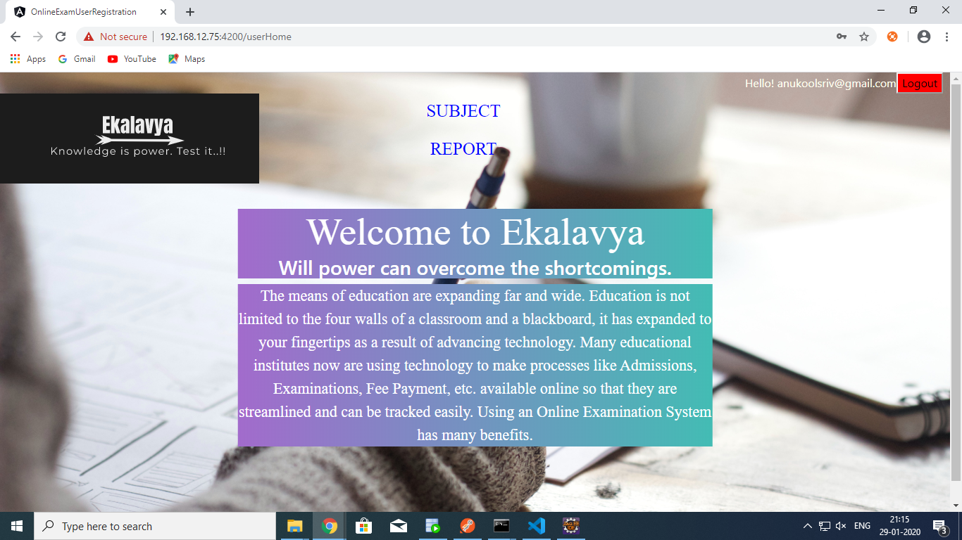
User Homepage

Slide 13
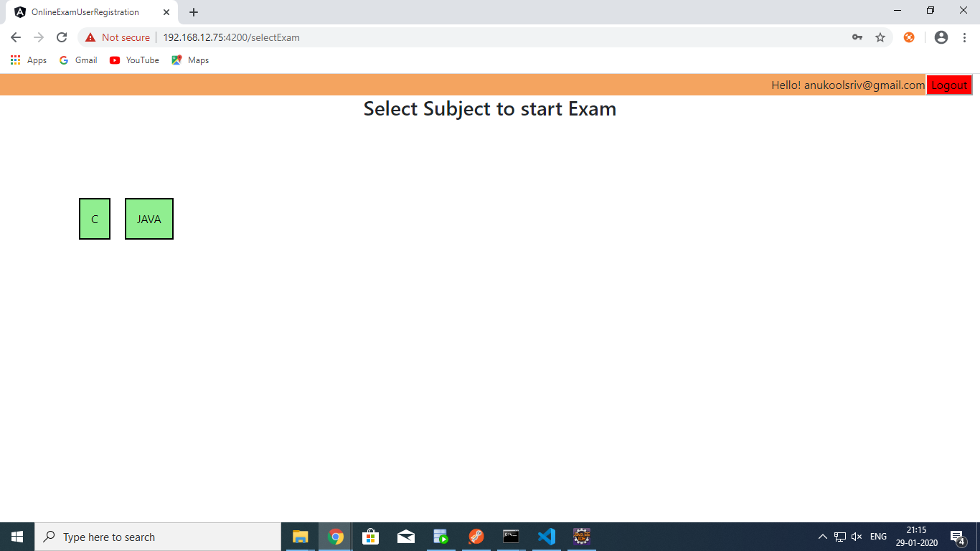
Selecting Subject

Slide 14
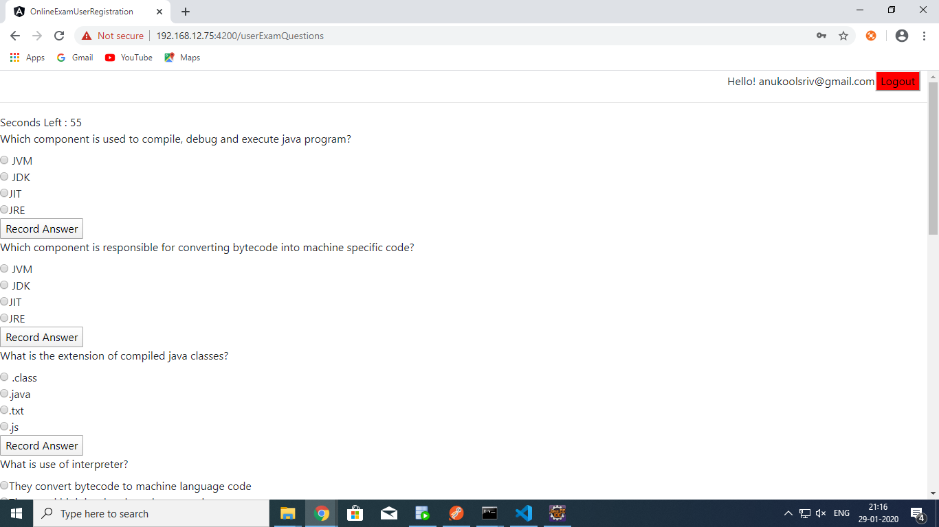
User Undergoing Exam

Slide 15
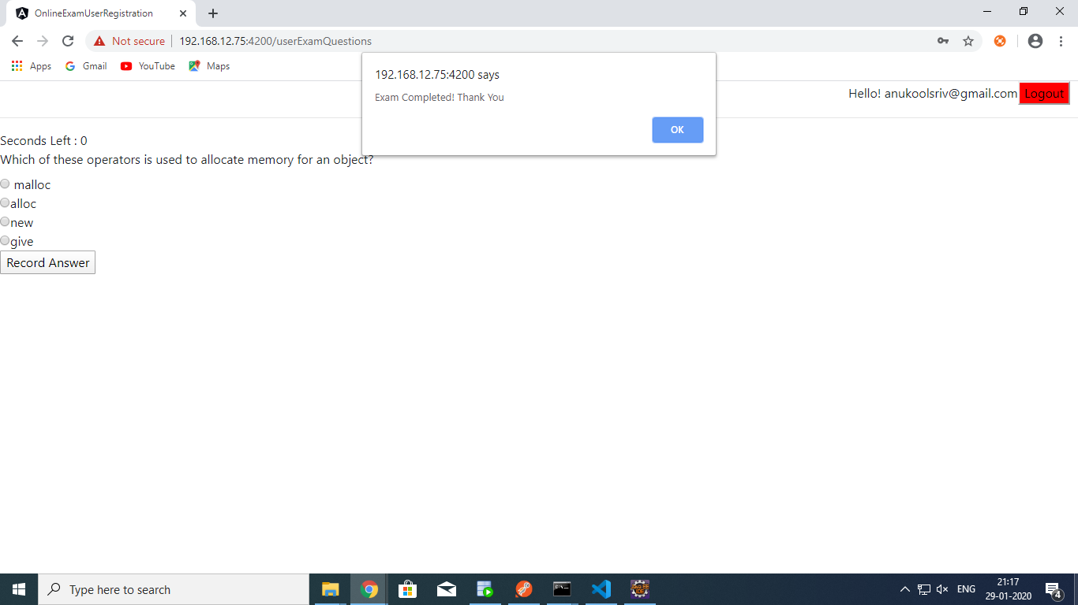
User Completed Exam

Slide 16
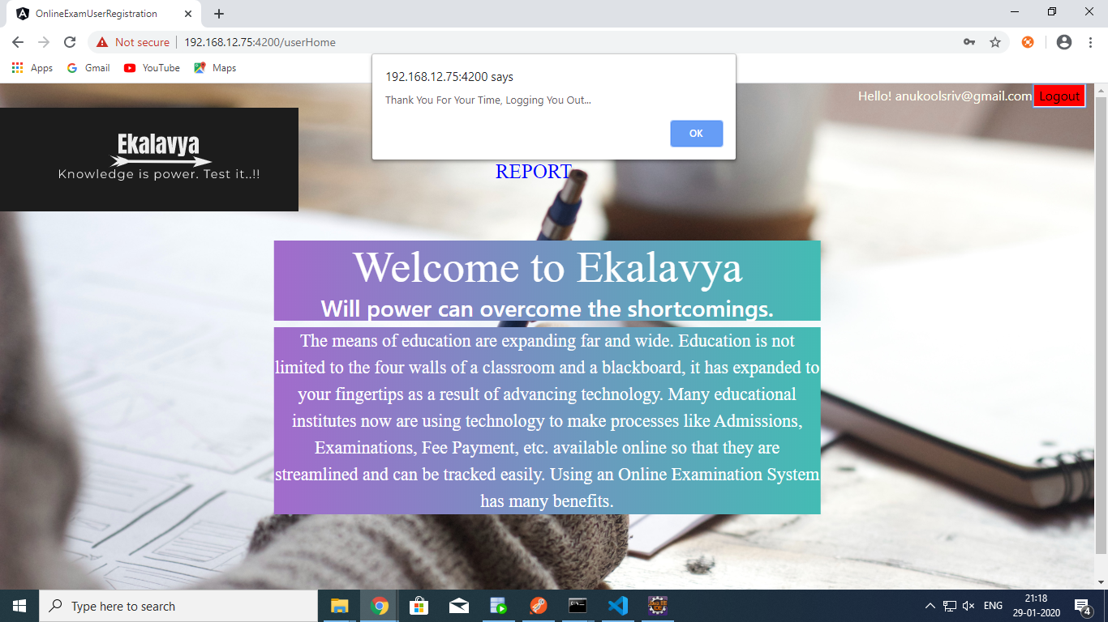
User Logout

Slide 17
